Slide 1
Optical Filters for Life science applications
Mike Scobey
Alluxa Inc.

Slide 2
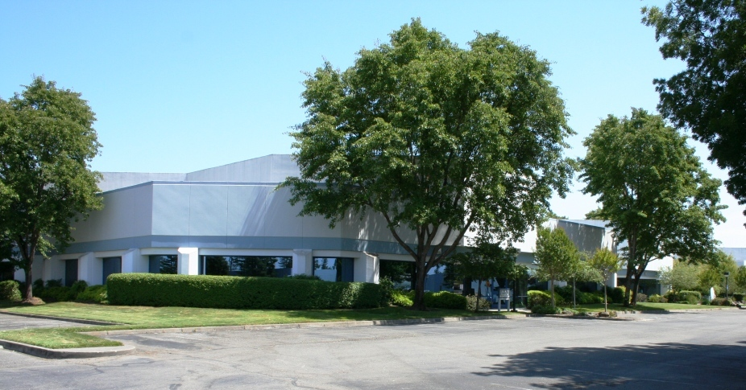
Alluxa Inc.
Santa Rosa, California.
8 years old, growing steadily, now with 55 employees with 20 engineers
Proprietary SIRRUS plasma PVD deposition process
In house chamber process design/development
10 identical, state-of-the-art plasma deposition chambers and growing
24x7, fully automated operation with clean operations throughout

Slide 3
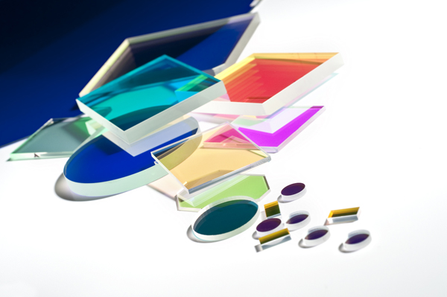
Thin film optical filters
Principle of constructive and destructive interference
Alluxa films are all hard-oxide and extraordinarily environmentally durable.
Modern filters may have up to 400 layers
Low Index
nQW
High Index
QW = λ₀/4

Slide 4
Common types of optical filters
Type | Layers | Function/Description | Typical Tolerances (+/-)
AR | 1 to 20 | Suppress reflection | 5-10%
HR | 30 to 150 | High reflection across a band | 2-5%
Bandpass | 60 to 250 | Transmit one band, reject all others on each side | 0.5% to 5%
Multi-bandpass | 200-400 | Transmit multiple bands, reject all others | 0.25% to 1%
Edge filter | 40-200 | Transmit one band, rejects adjacent bands | 0.5% to 5%
Dichroic | 50-150 | Tilted edge filter. Generally requires flatness | 0.5% to 2%
Notch | 200-500 | Reject narrow band, transmit all others | 0.25% to 1%
Multi-notch | 400-2000 | Reject multiple narrow bands, transmit all others | 0.25% to 1%

Slide 5
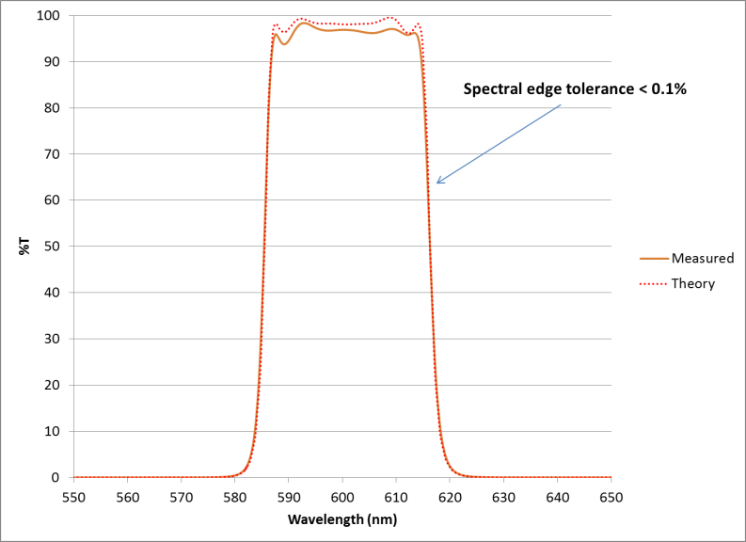
Sirrus Deposition platform
Proprietary to Alluxa
High energy plasma PVD
Extraordinarily durable, hard oxide coatings
Virtually no scatter or absorption loss
Fastest deposition in the industry enables lower price points and higher performance
Ultra-precise layer deposition using proprietary optical monitoring and control systems
Copy exact – 10 chambers

Slide 6
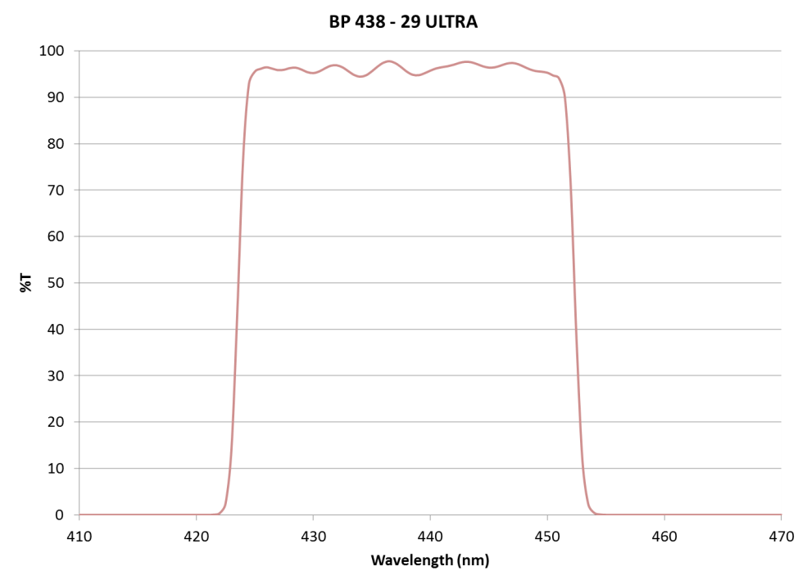
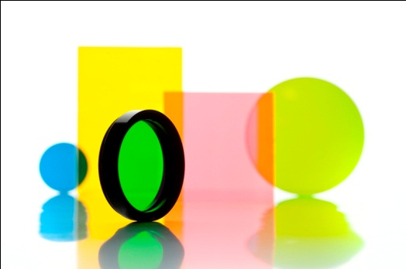
Alluxa’s Ultra Series Optical Filters
Parameter | Alluxa ULTRA | Leading competitor | Notes
Transmission | 95% | 92% | Alluxa typical is 98%
Blocking | Broadband OD6 to OD10 | OD6 but over narrow bands with OD10 available | Measurement limited at OD6
CWL control | +/-1.5nm or less | +/-3nm | Key for S/N and lower bleed thru
Slopes | 0.5% to OD6 | 1% to OD5 best case | Coupled with CWL control gives much improved bleed thru and crosstalk

Slide 7
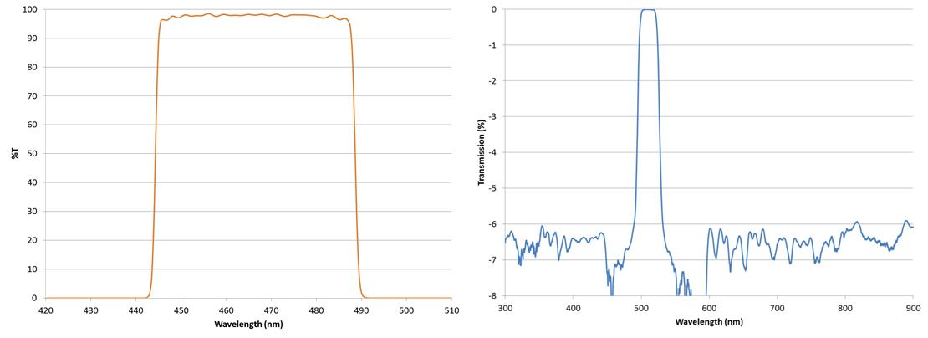
Ultra Series BP for Life
Performance leader with repeatable >95% transmission, ultra-tight wavelength control and wide OD6 out-of-band blocking

Slide 8
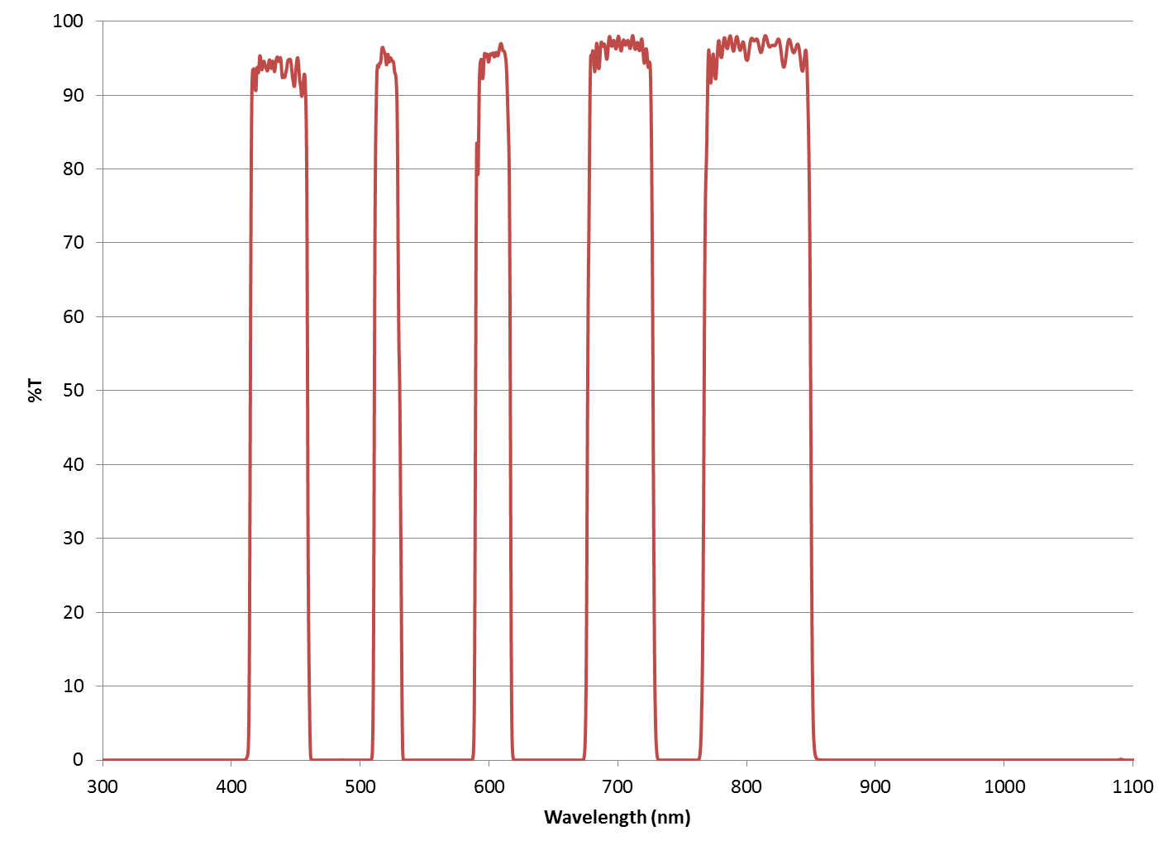
Ultra-series Multi-band EX and EM filter

Slide 9
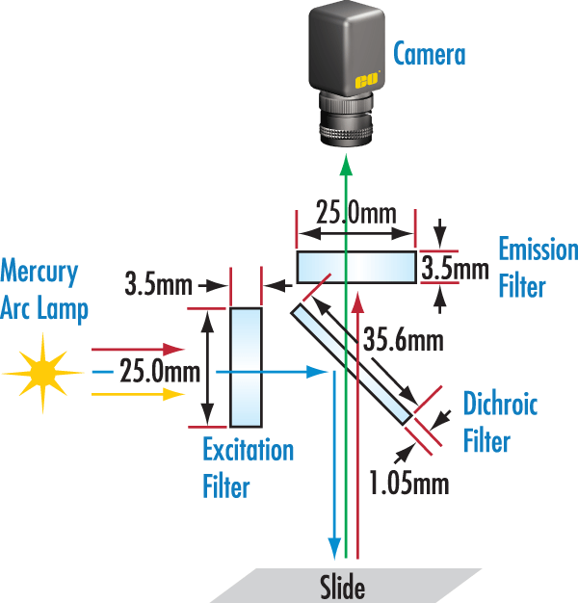
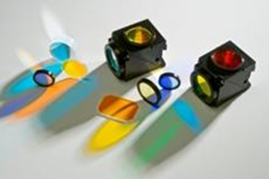
Fluorescence Microscopy
Requires non-overlapping bandpass filters with high blocking for excitation and emission
Dichroic filter for beam steering

Slide 10
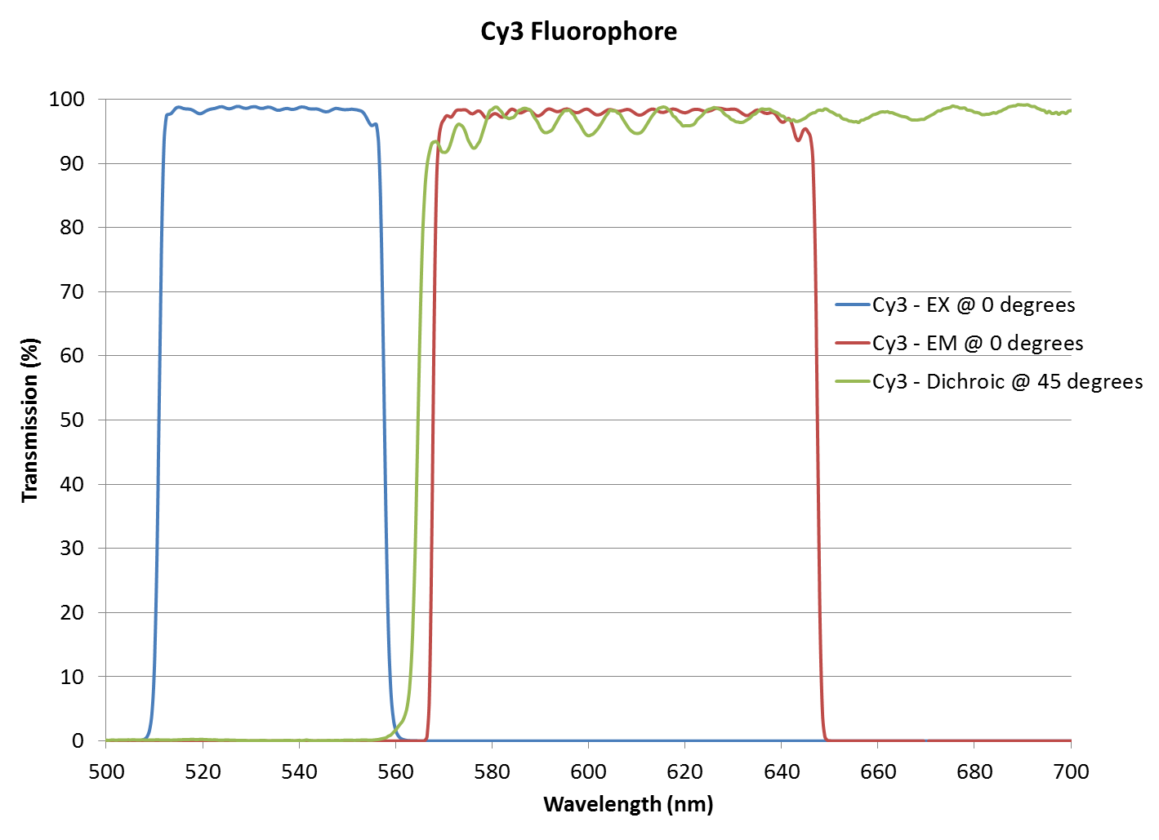
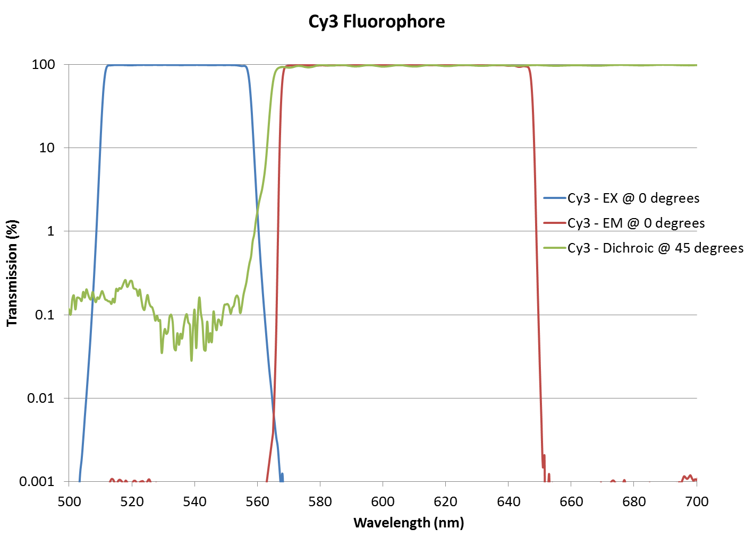
Typical Ultra fluorescence Filter Set

Slide 11
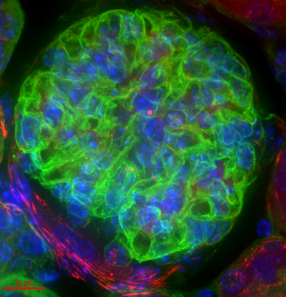
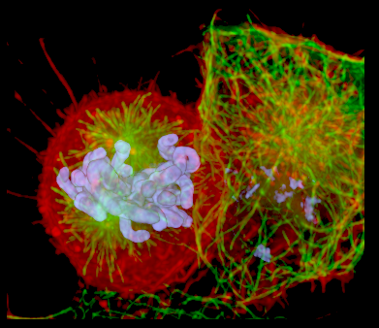
Fluoresce Microscopy images
Chinese
Hamster Ovary
Kidney

Slide 12
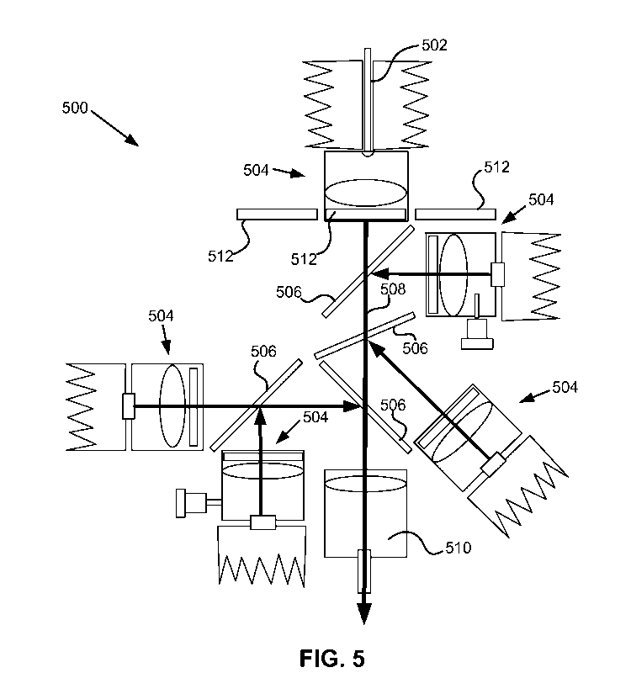
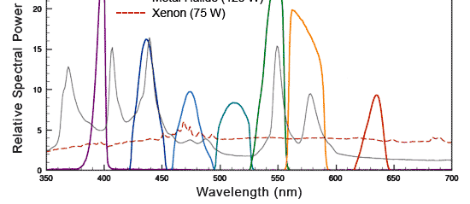
LED Illuminators
Gaining share in microscopy as well as OEM instruments
Energy efficient and rapid on/off
Mercury free, long life
Dichroic filters and precision bandpass filters

Slide 13
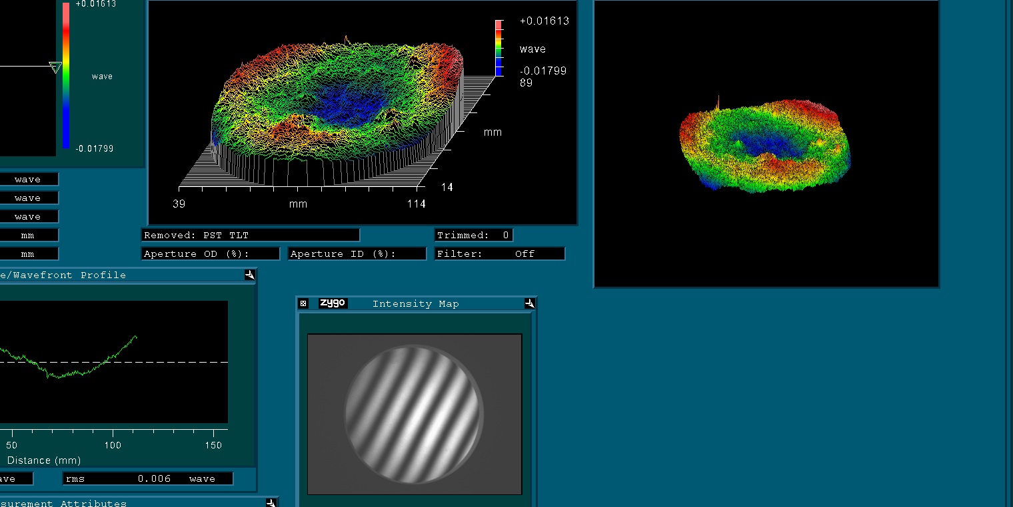
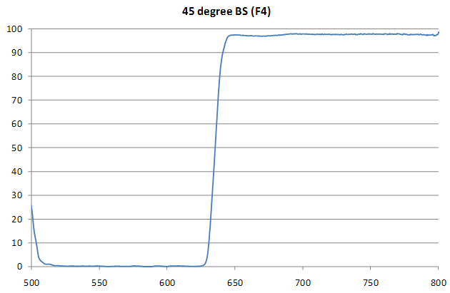
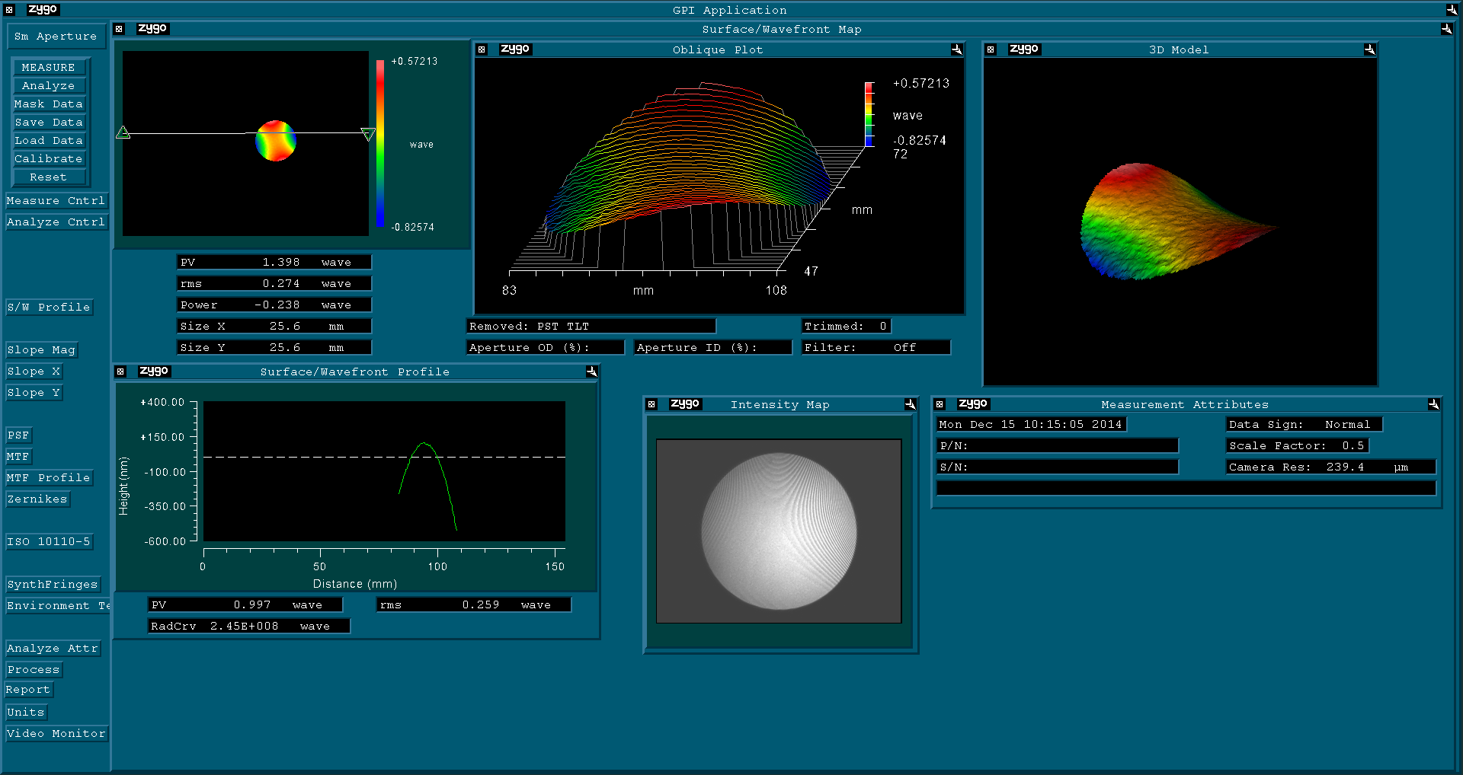
Ultra flat dichroics

Slide 14
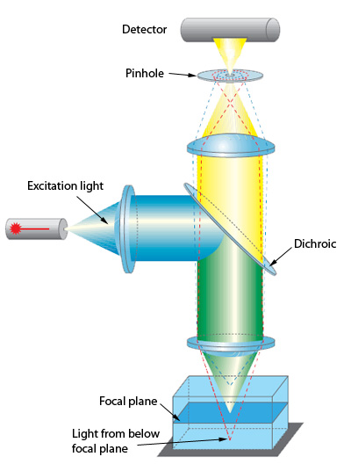
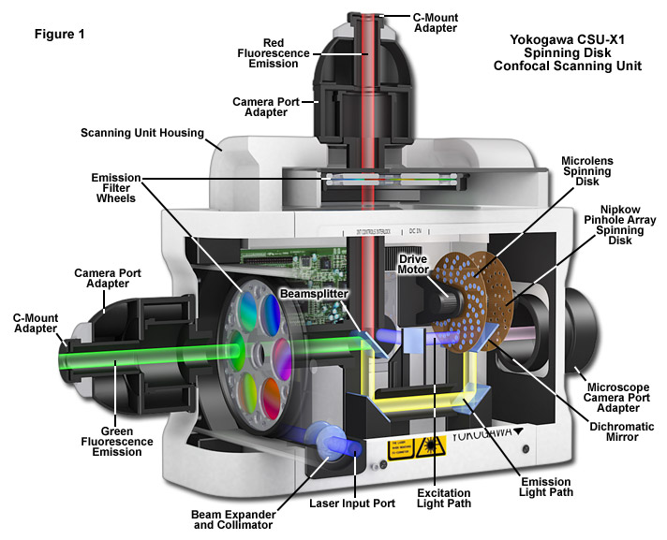
Confocal Microscopy

Slide 15
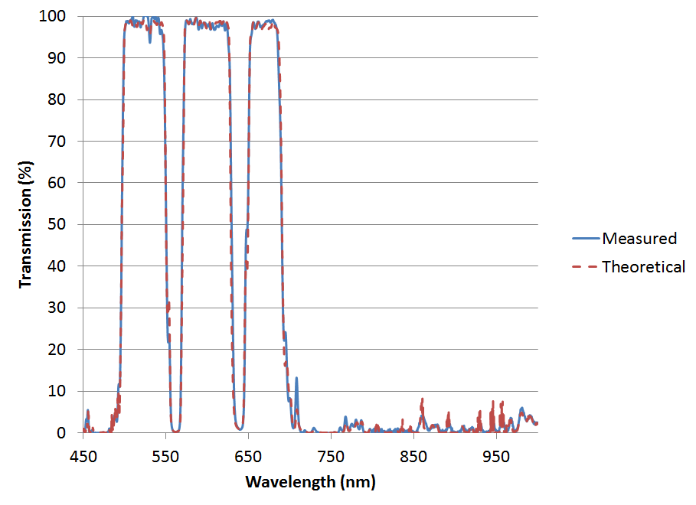
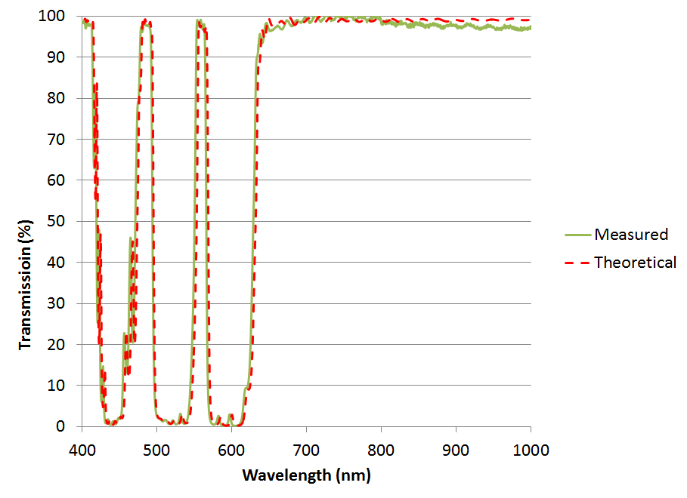
ULTRA Quad-chroics for confocal Microscopy
Ultra-flat available

Slide 16
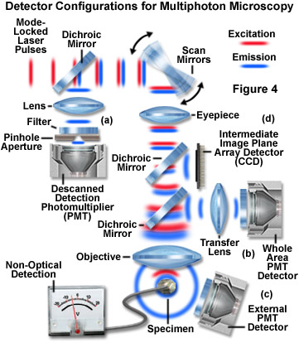
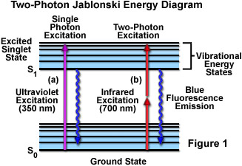
Multiphoton Microscopy
From Nikon U

Slide 17
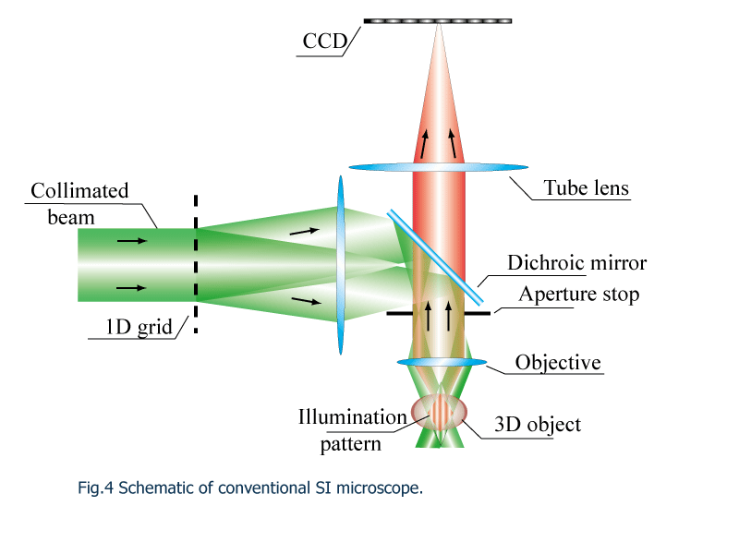
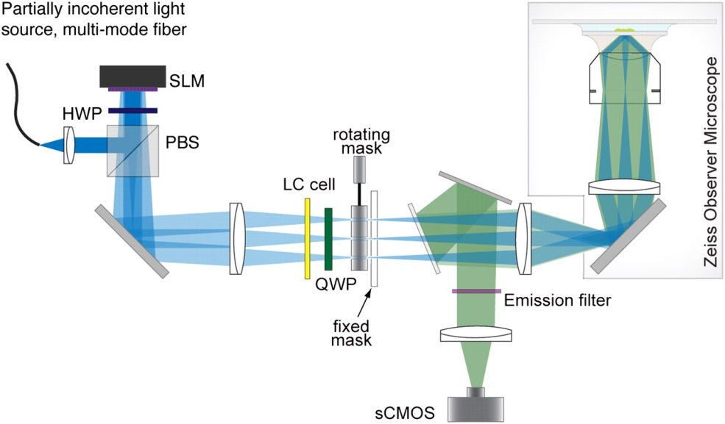
Structured illumination
Super resolution techniques to defeat the diffraction limit
Dichroics, Bandpass, phase controlled mirrors, among others

Slide 18
stimulated emission depletion (STED) microscope
Excitation Beam
APD
PH
QWP
BPF
λ 488 nm
DCLP
Depletion Beam
NF
λ 592 nm
DCSP
BPF
VPP
P
QWP
Objective
STED Image

Slide 19
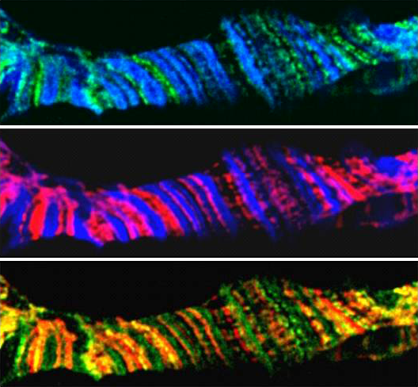
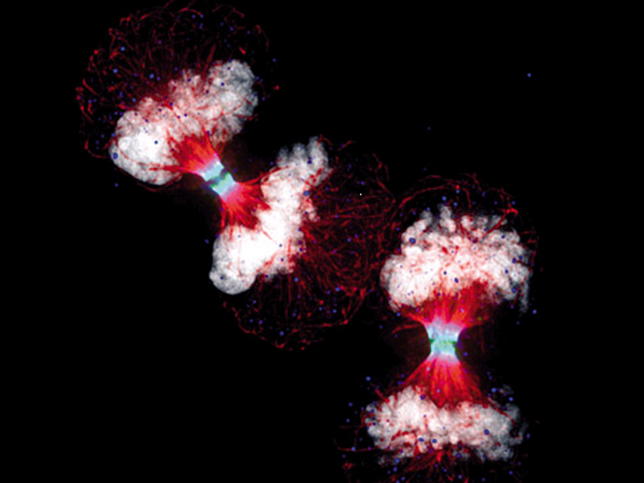
Images using STED Super resolution
Chromosome bands
HELA Telophase

Slide 20
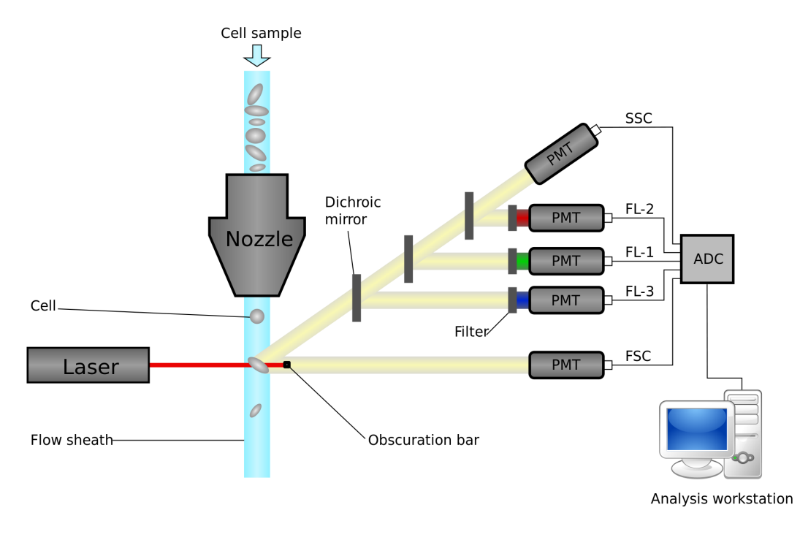
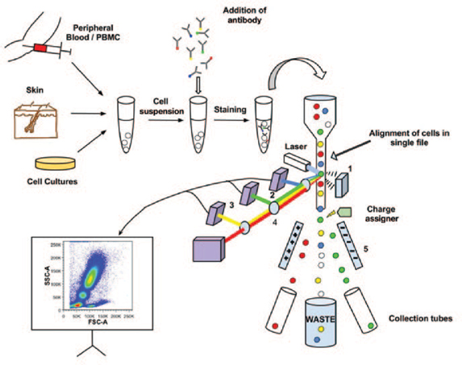
Flow cytometry
Single cell counting and sorting
Single and multiband dichroics, bandpass, narrowband filters

Slide 21
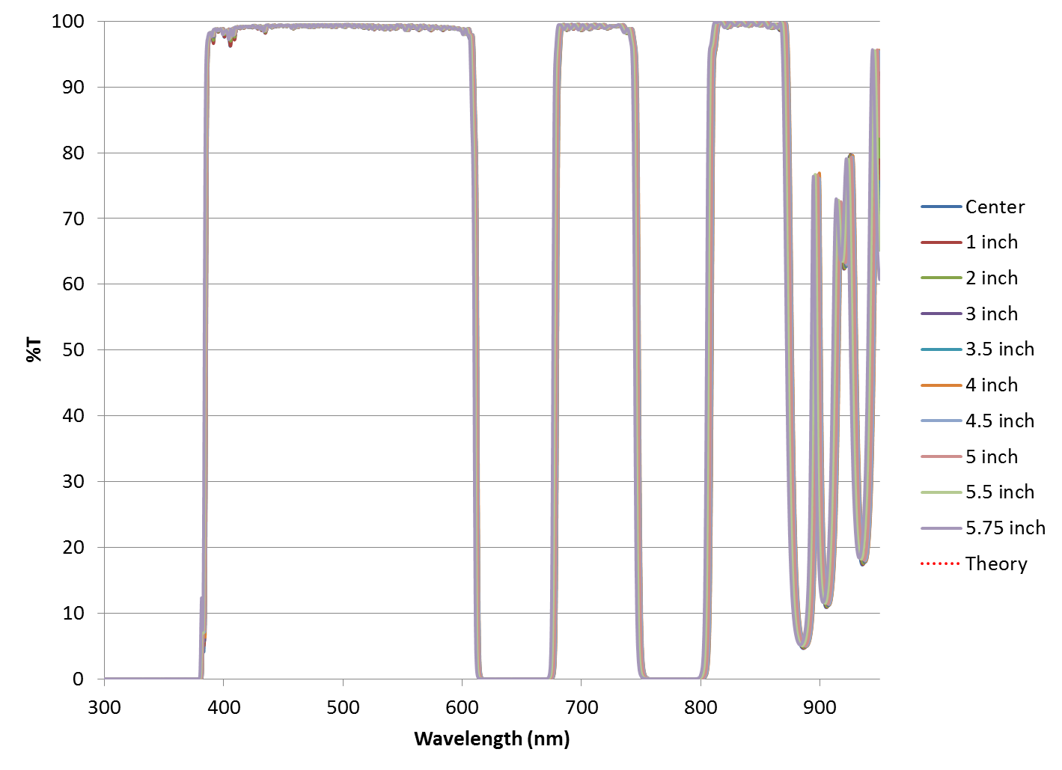
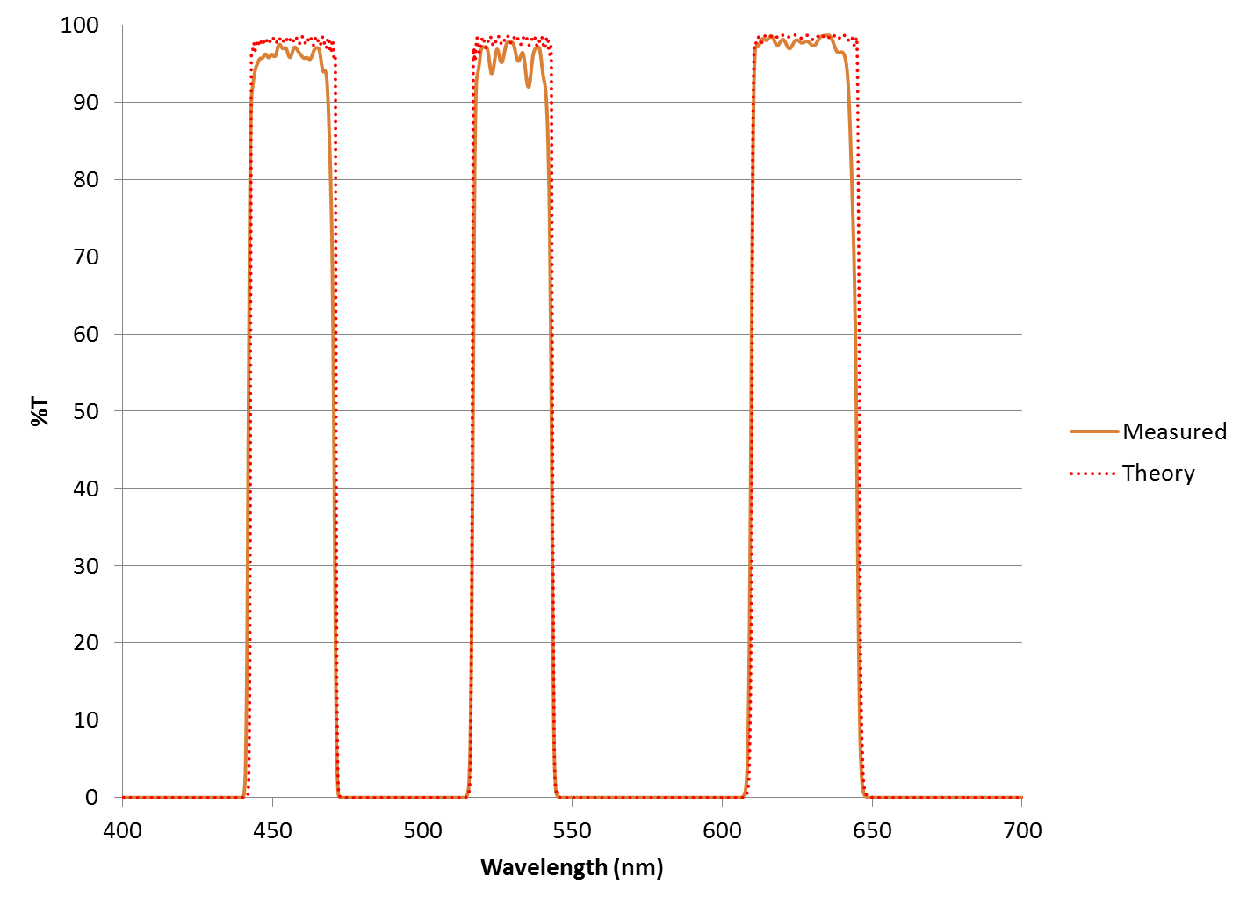
Flow Cytometry Ultra multibands

Slide 22
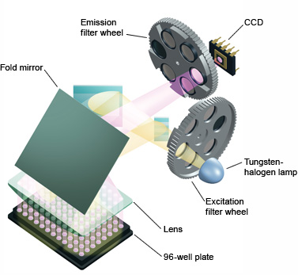
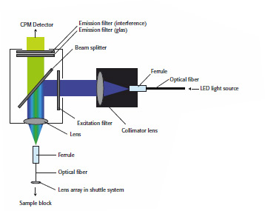
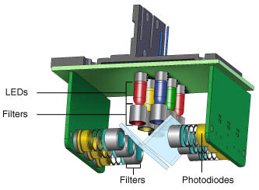
PCR systems
DNA amplification for analysis
Dichroics, bandpass, narrowband filters

Slide 23
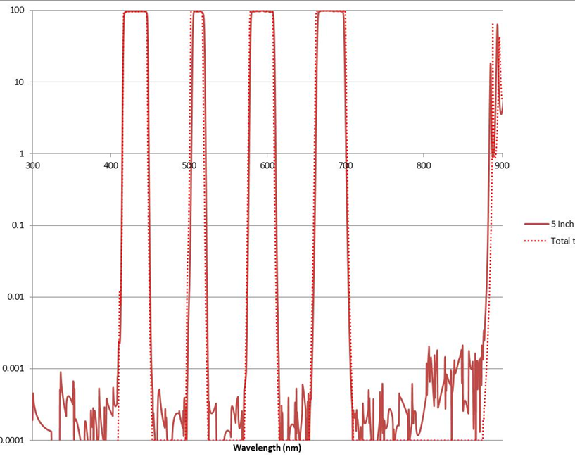
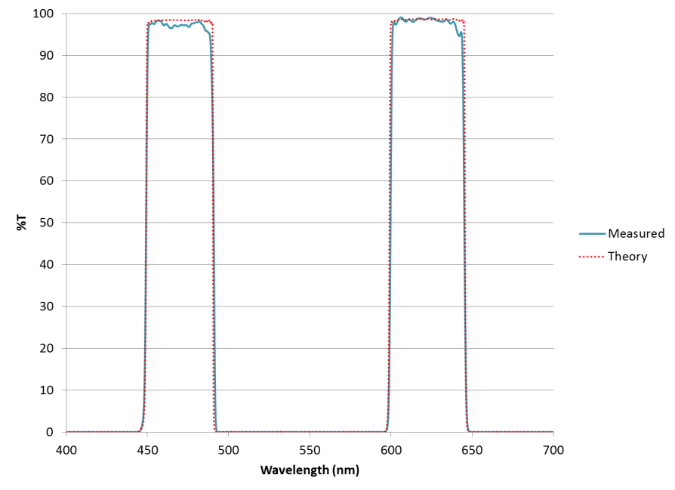
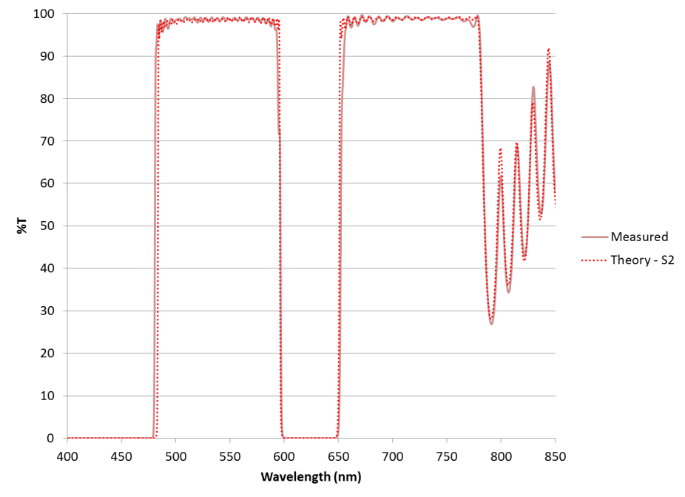
ULTRA Multi-Bandpass EMission Filters

Slide 24
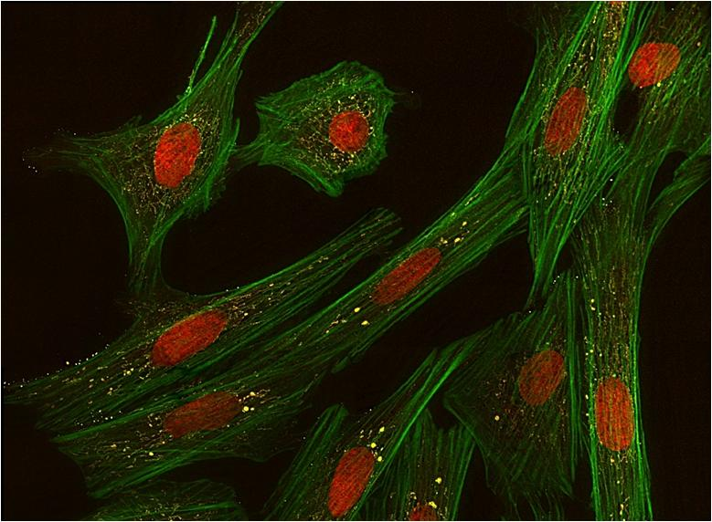
Multiband microscopy results
Taken using Alluxa Quad Band Dichroic and Tri-Band EM Filters

Slide 25
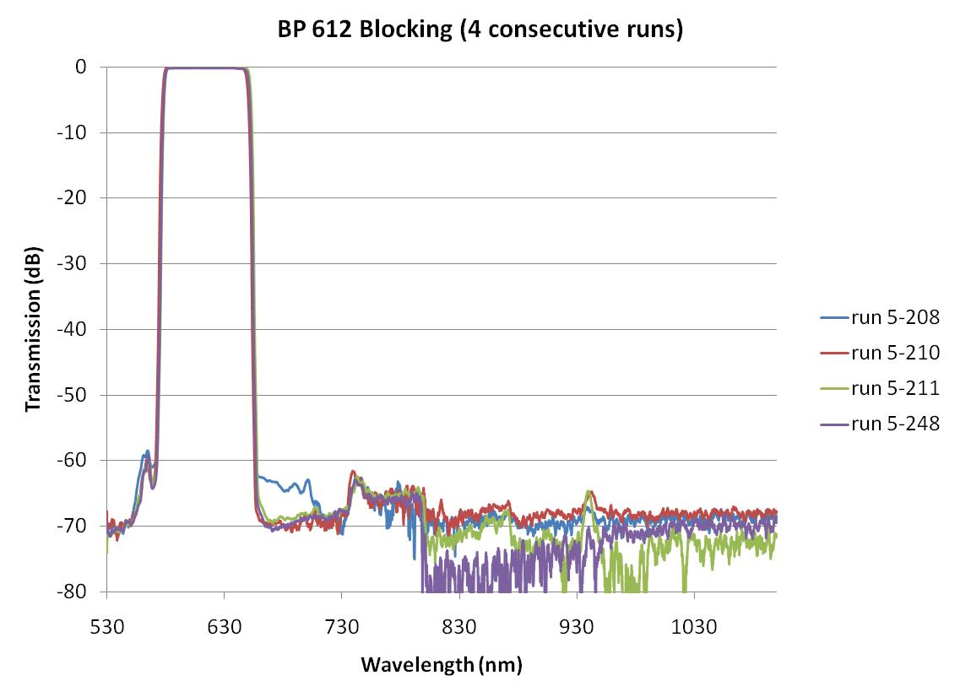
Automation and process control enables repeatability

Slide 26
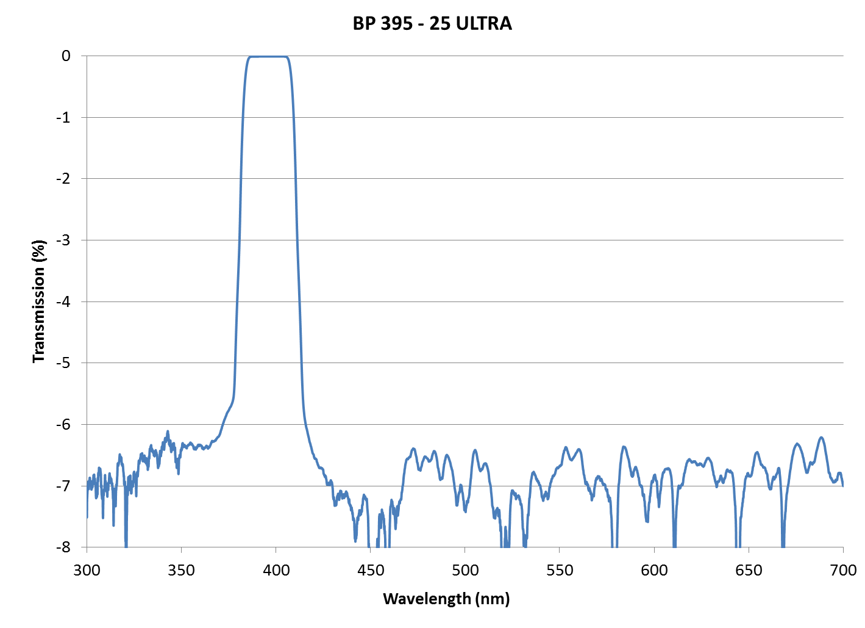
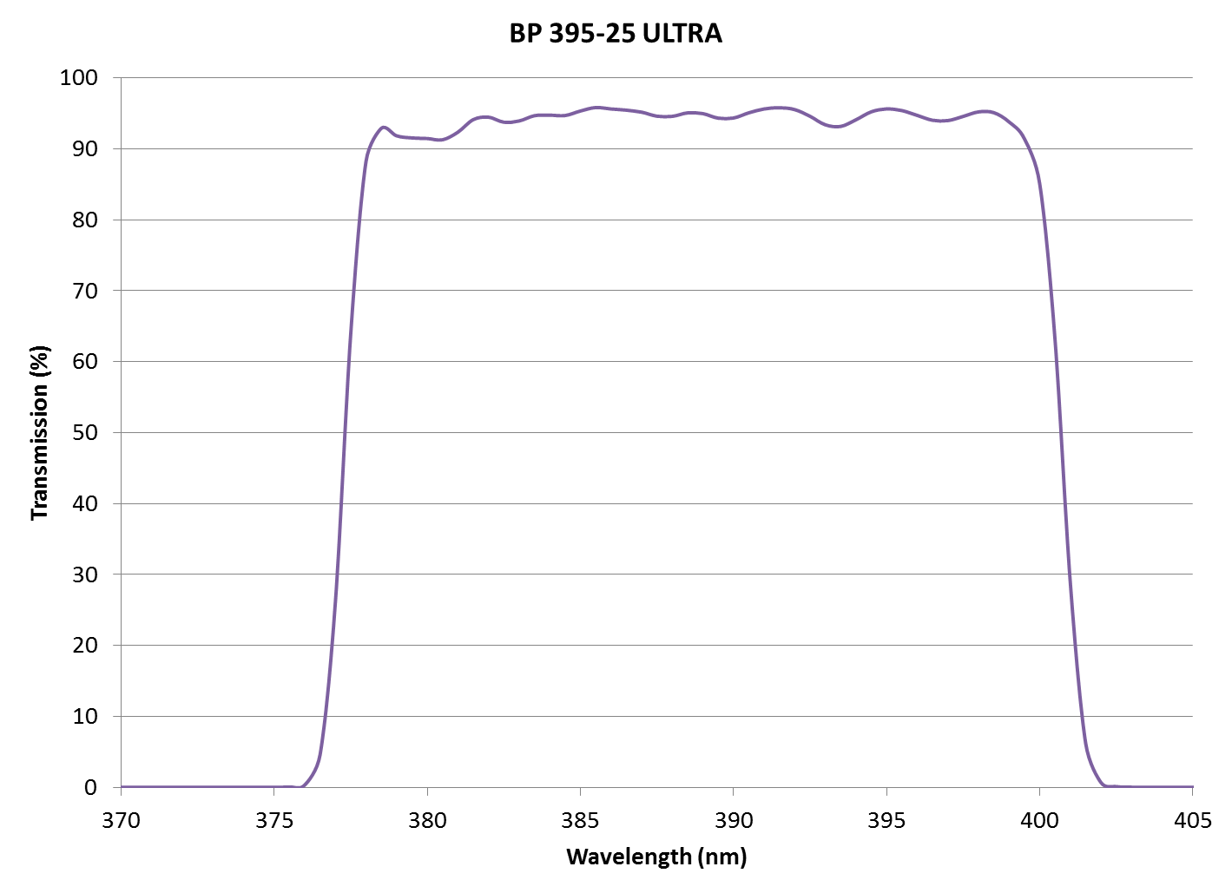
ULTRA UV Band Pass Filters

Slide 27
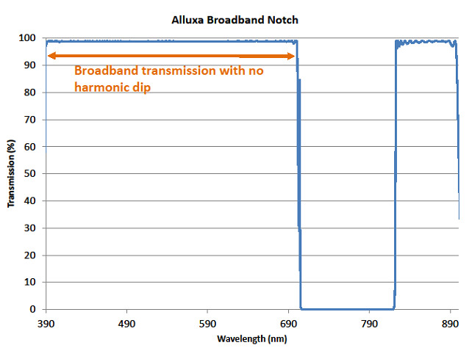
fluorescence with visible imaging filter

Slide 28
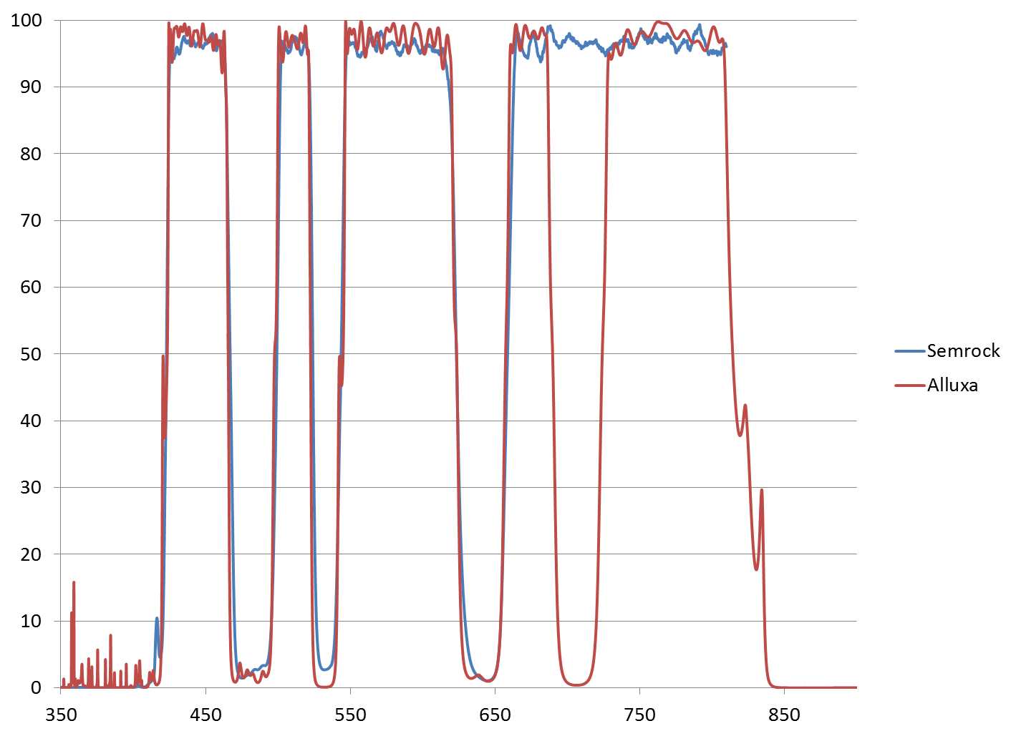
Rapid turn custom filters
Catalog quadchroic converted to a penta-band
Order, design, fab in < 4 weeks
Added 5th notch
Competitor

Slide 29
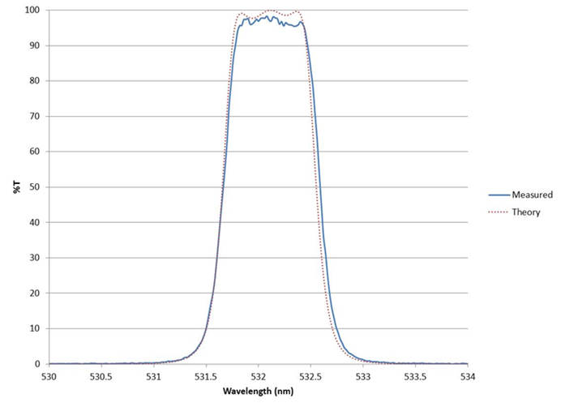
Ultra-narrow Multicavity BP’s
Bandwidths to <0.2nm with large formats available.
Multicavity designs for square spectral performance
Unique product offering of bandwidth and size
63 wavelengths now shipping from our new on-line store

Slide 30
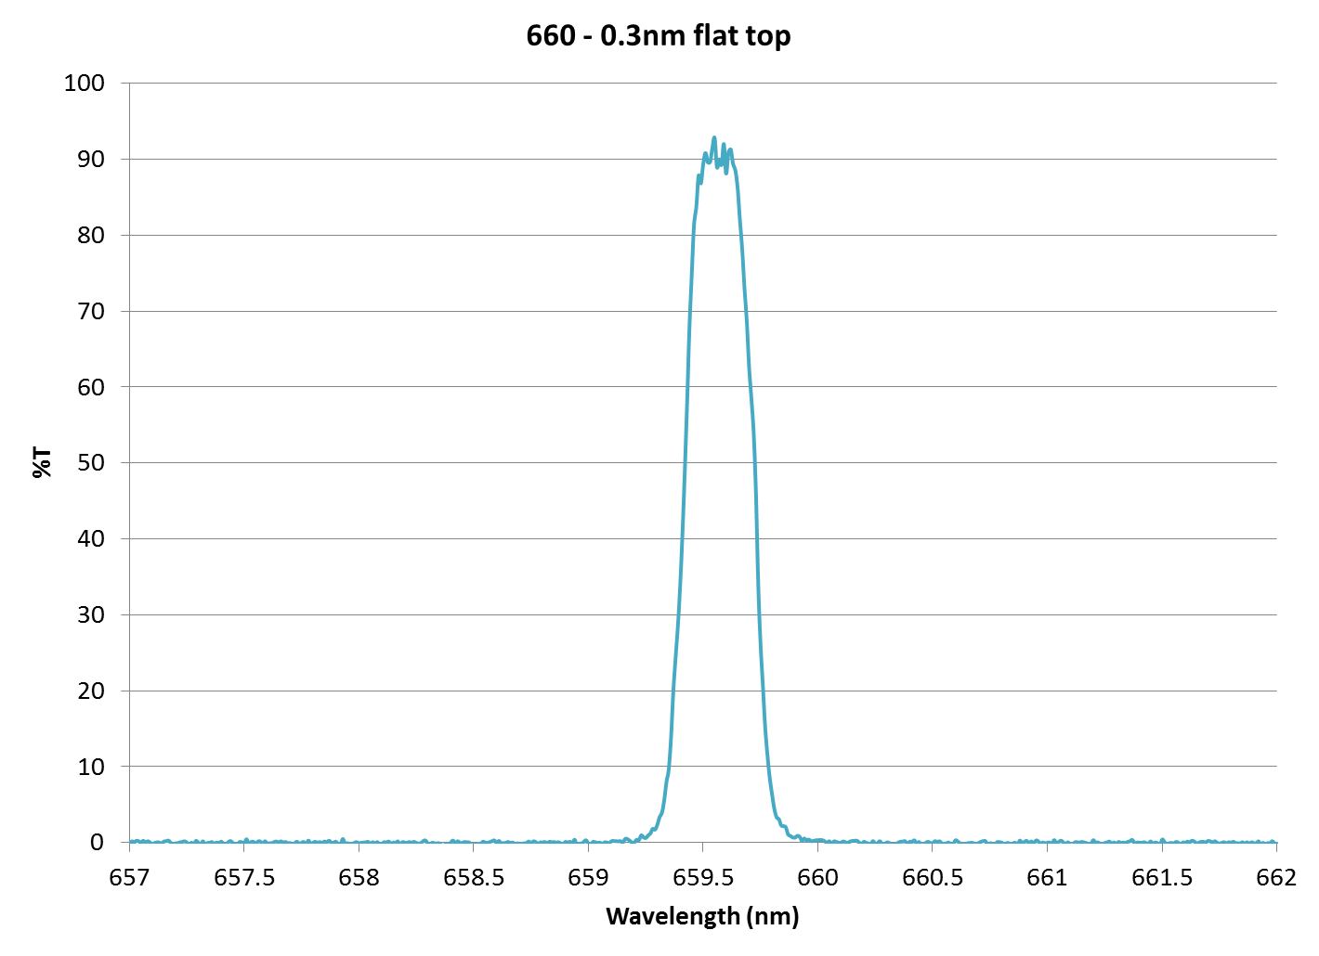
Really Ultra Narrow!

Slide 31
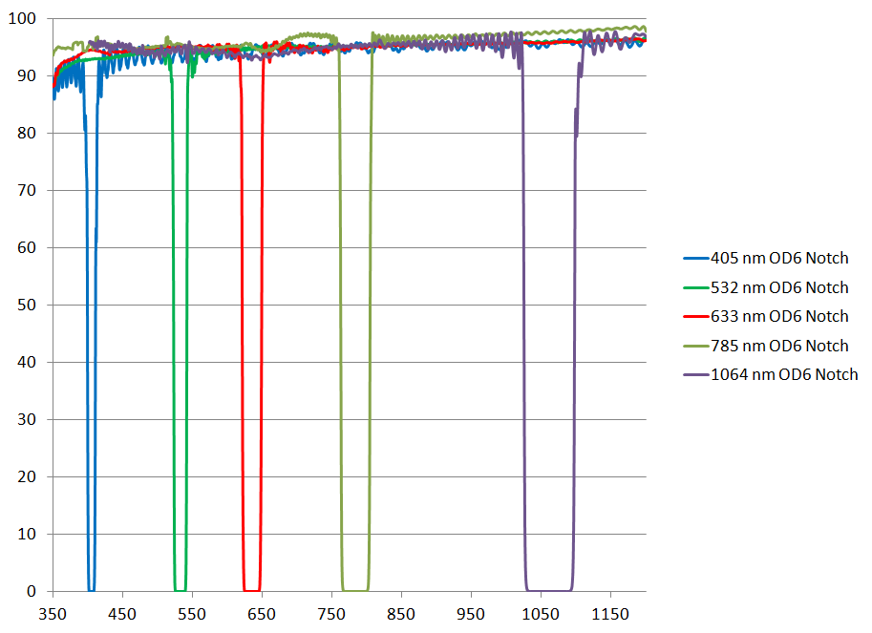
Ultra narrow OD6 Notch Filters with wide transmission

Slide 32
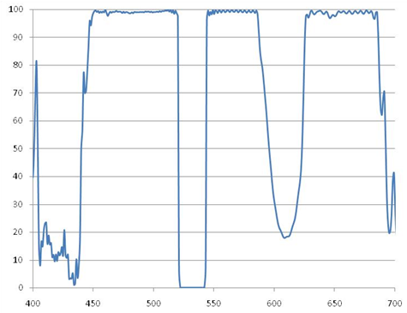
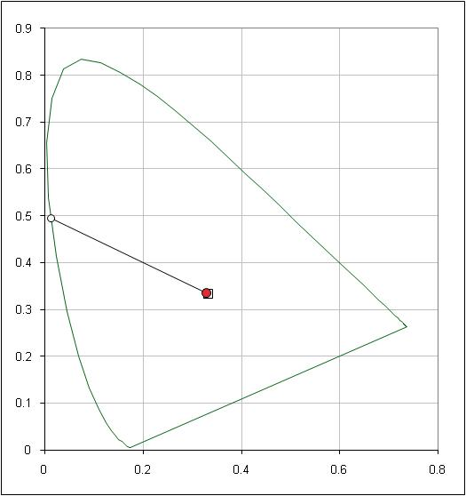
Color corrected notch for laser surgery

Slide 33
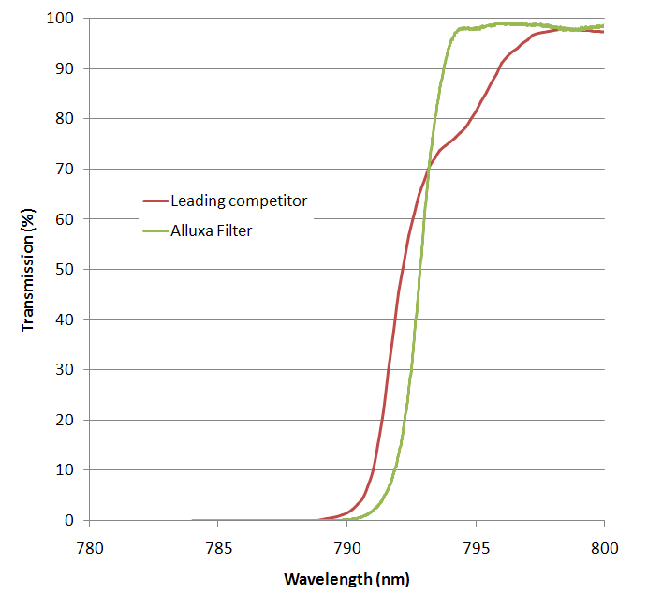
Raman 785nm LWP

Slide 34
Low cost LED edge Filters for forensics
Consumable for flashlights at crime scene investigation

Slide 35
Low Cost Catalog OD4 Filters

Slide 36
Arbitrary shape filters

Slide 37
Summary
Innumerable applications for optical filters in Life Sciences
Rapidly developing coating technologies are pushing the state of the art
The SIRRUS deposition platform enables Alluxa to be at forefront of performance while improving price points
Alluxa is always up for new challenges!

